Slide 1
MCA - My Clubcard Account
Narendra

Slide 2
Agenda
Introduction
Marketing overview
MCA integration with other systems
MCA – What is it ?
MCA site map and impacted processes
New and impacted capabilities
MCA screens
Customer journey
iGHS and MCA

Slide 3
Introduction
In order to gain the loyalty of the customers TESCO had launched Clubcard in the year 1994.
All the Clubcard holders are sent coupons based on their shopping habits, life stage, life style, geographic location.
Coupons are thus highly targeted based on the above mentioned range of attributes.
TEPLOG is the file generated by the stores which has the record of everything that the customer is buying and this file is ultimately sent to DHA(Dunn Humby Associates) for analysis of customer buying habits. Based on this, coupons are sent to customers.
Some examples of coupons are bonus coupons, price promise coupons

Slide 4
NGC is a loyalty solution. The purpose of a loyalty solution is to encourage customer affinity with a brand.
Loyalty is encouraged by offering periodic incentives to customers in club card which are proportional to the amount of spend.
NGC, as an example of a loyalty scheme – specifically related to the Tesco brand, operates by offering a cash equivalent reward as a direct conversion of the amount of spend by a customer.

Slide 5
Marketing overview
NGC/Marketing
NGC
MCA
SV
CC
CSU
Kiosk
CG/KG
NGC(Next Generation Clubcard) : NGC is a loyalty solution ,specifically related to the Tesco brand, operates by offering a cash equivalent reward as a direct conversion of the amount of spend by a customer .
MCA(My Clubcard Account) : MCA ) is a loyalty web application for customers. It enable customers to engage with Tesco and grow their loyalty. It also allow customers to manage their online account from a single place.

Slide 6
SV(Smart Vouchers) : To ensure that cash vouchers issued are redeemed once and to reduce fraud SV was introduced in 2005. The “Smart” in Smart Vouchers(22 digit code) denotes the unique barcode that is tracked in real-time to prevent multiple redemption of the same voucher.
CC(Clubcard Coupons) : In order to gain the loyalty of the customers TESCO had launched Clubcard in the year 1994. All the Clubcard holders are sent coupons based on their shopping habits, life stage, life style, geographic location.
CSU(Coupons Setup) : It defines and maintains coupons and vouchers that will be made available to customers. It also communicates information about coupons and vouchers to other systems.
Kiosk : Kiosk is an in-store self-service channel that provides Clubcard customers with three functionalities such as Join Clubcard, Print your Clubcard Vouchers & Coupons, Clubcard Boost at Tesco.
CG/KG : These Mainframe systems hold points data of customers for UK(CG) and ROI(KG) respectively.

Slide 7
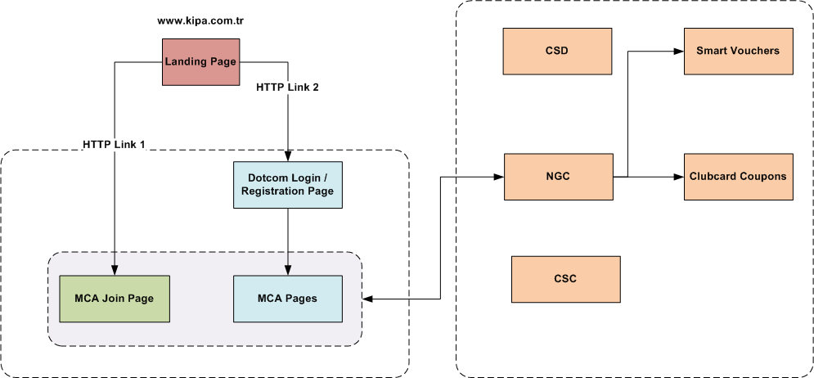
MCA integration with other systems

Slide 8
MCA – What is it ?
My Clubcard Account (MCA) is an online view of a Customer’s Clubcard account. It’s a great tool for tracking with how their points are progressing and keeping their details up to date.
CUSTOMERS CAN:
Change their personal details
Review their Clubcard points balance (Customers can view points collected in the past XX statements as well as their transaction details)
View which Clubcard vouchers & coupons they have available to use (only those issued from XY) – once Customer used them these will appear in used coupons / vouchers section
Print their Clubcard vouchers & coupons at home on their printer (only those issued from XY) and then use in store
WHAT YOU SHOULD BENEFIT FROM WITH MCA LAUNCH:
Reduced number of Calls
Correct Customer data
Customers feel more interactive with the scheme
Personalization

Slide 9
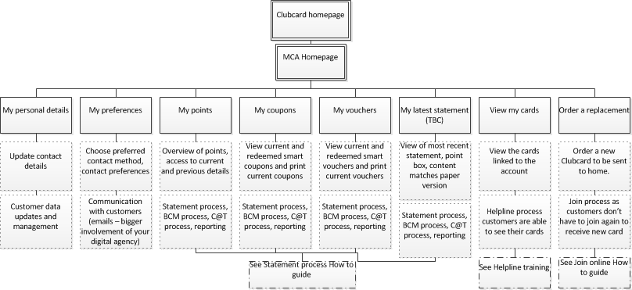
MCA site map and impacted processes
MCA SITE
Content
Process Impacted
UK has Christmas savers as a scheme, Visible in MCA , we do not have the same mechanics for Group ,
more information
http://www.tesco.com/clubcard/christmas-savers/

Slide 10
New and impacted capabilities
Capabilities | Overview
Join Process | Online Avenue, Replacement Cards, more information in “join in store and online guide”**
Managing Account | Customers now enabled to managed their own account /update information by themselves as-to the current of getting that done via helpline
Print @ home | Customers can download their Clubcard / Coupons / Vouchers from MCA as many times as needed. Process Related to “Reissue” is now enhanced
Communication with Customers | Communication is more digital , MCA Needs to be added to all clubcard materials (Hard/ Soft/ Stores/ Online)
Statement Processes | Smart coupons & Vouchers , Points details , transactions all are visible to customers
Helpline Processes | Additional Set of Queries for Helpline, effect to the new and changed Process , more details in the helpline training guide
Store Processes | Stores would have to updated on the new functionality**
Reporting | New issuance channel for coupon and vouchers

Slide 11
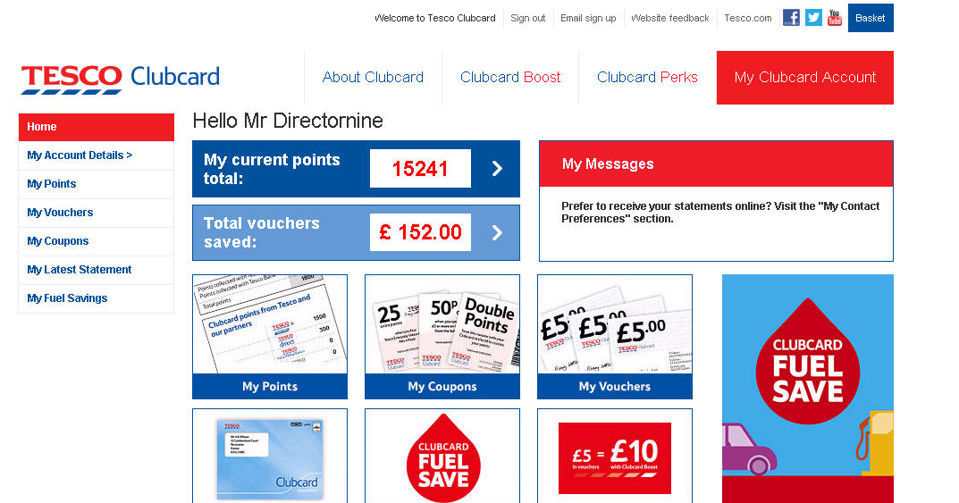
MCA screens

Slide 12
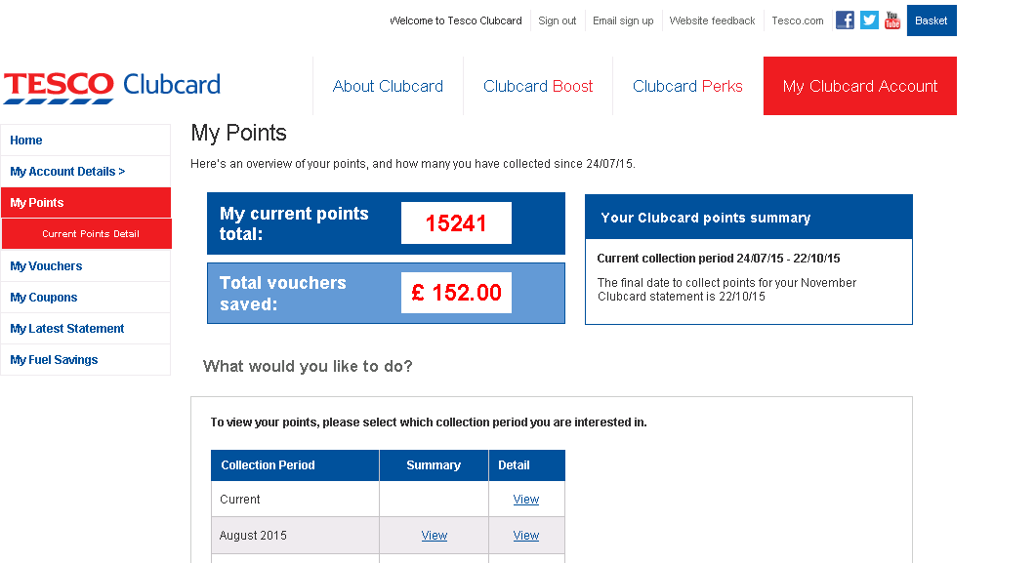

Slide 13
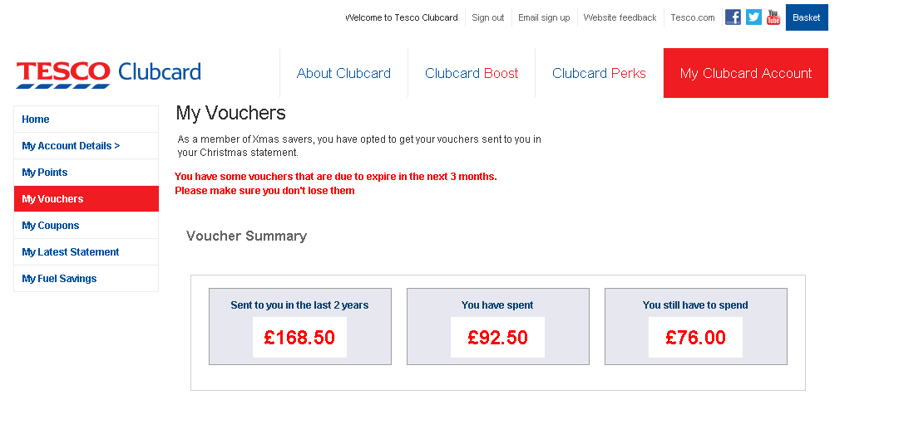

Slide 14
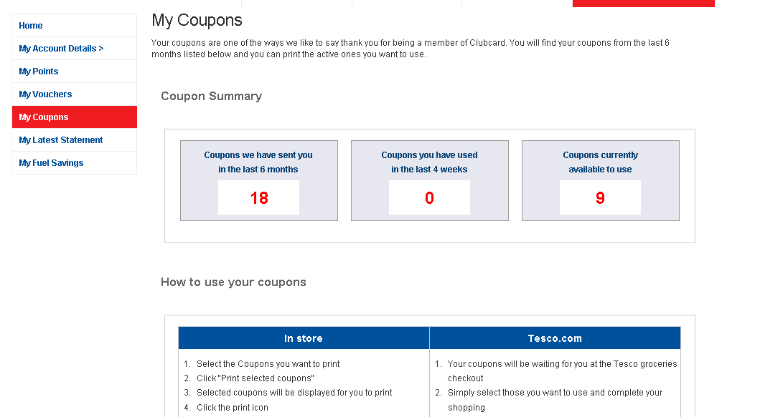

Slide 15
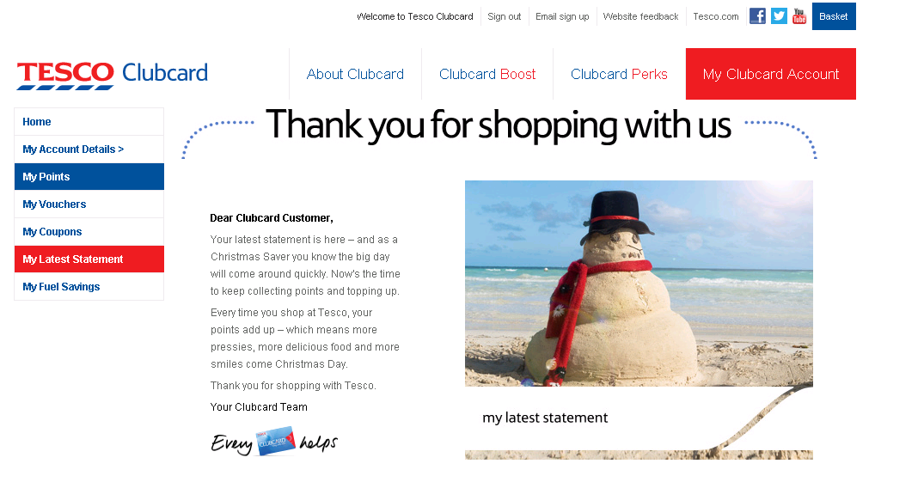

Slide 16
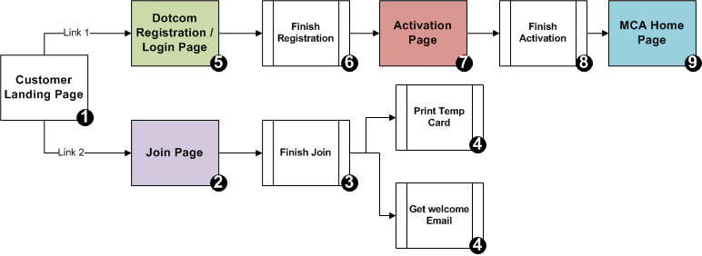
Customer Journey
“one time” activity for MCA (registration)
“one time” activity for MCA
Customers needs to be Registered with GHS before they can start using MCA . This is a “One time” Activity
A MCA Customer already using GHS automatically jumps on to Step 7 from 1 and carries on the rest of the steps to the “MCA Home Page” .
More details in “MCA Registration How to Guide”

Slide 17
iGHS and MCA
GHS Login is a Pre-requisite to have MCA Live in any Group county
All Clubcard would use the existing GHS Login to access MCA
User management ( password reset , new user registration would happen via GHS Login)
This is to unify and simplify user management and protect customer data
Customer Landing Page should have two links
For Login / registration ( for Existing clubcard users) this takes us to GHS Page
For Join ( New clubcard customers who wishes to join the scheme) one completion of join customer moves to the Login / Registration link

Slide 18


